Slide 1
EthosAgentAI: An Ethical, Multi-Model Agentic AI Ecosystem for Fair Hiring and Intelligent Skill Development Aligned with SDG 8 and SDG 9
Dipro Paul
ID : 221-15-5666
Department : CSE
Daffodil International University

Slide 2
Outline
Introduction
Objective
Background Study
Gap Analysis
Methodology
Results & Analysis
Novelty of the Work
Conclusion
References

Slide 3
Introduction
Every year, thousands of Bangladeshi graduates enter the job market with hope but face unclear job requirements, biased screening, difficult online interviews and Personalized coach. Recruiters also struggle with huge applicant volumes and rising interview fraud.Seeing these real challenges inside DIU and my office, I asked: “Can we build an AI system that helps both students and recruiters fairly, transparently, and intelligently?”Under the supervision of Dr. S. M. Aminul Haque, I developed EthosAgentAI end-to-end AI ecosystem combining job matching, resume screening, personalised roadmaps, and real-time interview integrity. Now, it is ready to integrated into the Daffodil Career Hub to support fresh graduates as well as industry.

Slide 4
Objective
To design and develop a unified multi-agent AI framework capable of supporting end-to-end hiring and personalized career intelligent workflows.
To implement semantic job-matching mechanisms with explainable and transparent decision-making.
To develop an intelligent resume-screening module utilizing RAG, adaptive scoring, and structured evaluation criteria.
To identify candidate skill gaps and generate personalised, data-driven learning roadmaps.
To implement real-time interview integrity monitoring using MediaPipe, OpenCV, OCR, and vision-based detection models.
To integrate a personalised AI career-assistant chatbot for continuous guidance and interaction.
To achieve robust system performance, targeting ≥85% accuracy in resume screening and 95–100% accuracy in interview-integrity detection.
To ensure that the system aligns with SDG 8 (Decent Work and Economic Growth) and SDG 9 (Industry, Innovation and Infrastructure), supporting sustainable and ethical recruitment practices.

Slide 5
Background Study
Recruitment processes are increasingly digital, yet face challenges such as bias, inefficiency, and online interview fraud.
Job seekers often struggle with skill gaps and lack guidance to improve employability.
Recruiters face high applicant volumes, limited time, and manual screening constraints.
Existing systems are often fragmented: some focus only on job matching, others on resume screening, skill-gap analysis, or interview monitoring.
Research shows AI-based solutions (semantic matching, multi-agent screening, RAG, computer vision) can improve fairness, efficiency, and transparency.
In the context of Bangladesh, fresh graduates need personalised guidance aligned with industry expectations, while organizations require scalable and reliable evaluation systems.
This gap motivates the development of EthosAgentAI, a unified, end-to-end AI recruitment and skill-development ecosystem.

Slide 6
Gap Analysis
Current Solutions | Identified Gaps | EthosAgentAI Innovation
AI tools (HireVue, Eightfold, X0PA) handle isolated tasks like screening or interviews | No end-to-end recruitment ecosystem | ✅ Unified 5-layer architecture (Input → Processing → Knowledge → Decision → Output)
Academic research focuses on single-phase automation | Lack of full hiring lifecycle automation | ✅ Complete recruitment-to-career pipeline
Black-box AI decision making | Weak explainability & transparency | ✅ Explainable AI (XAI) & interpretable decisions
Biased datasets and biased decision risks | No built-in fairness auditing | ✅ Fairness-by-design & bias mitigation framework
No real-time interview monitoring | Interview integrity not ensured | ✅ Hybrid computer vision for real-time fraud detection
Recruitment systems disconnected from learning platforms | No skill-gap to learning roadmap link | ✅ Personalized skill-gap analysis & adaptive learning path
Single-agent or rule-based systems | No multi-agent reasoning ecosystem | ✅ Multi-agent system with RAG-enhanced intelligence
Closed, proprietary platforms | No open or reproducible research system | ✅ Open, ethical, and SDG-aligned AI framework

Slide 7
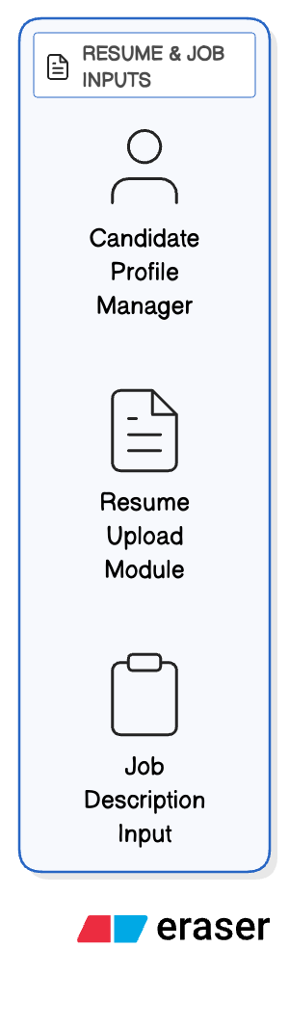
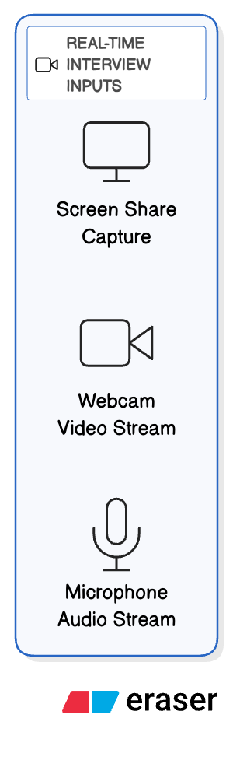
Methodology
(Input Layer)

Slide 8
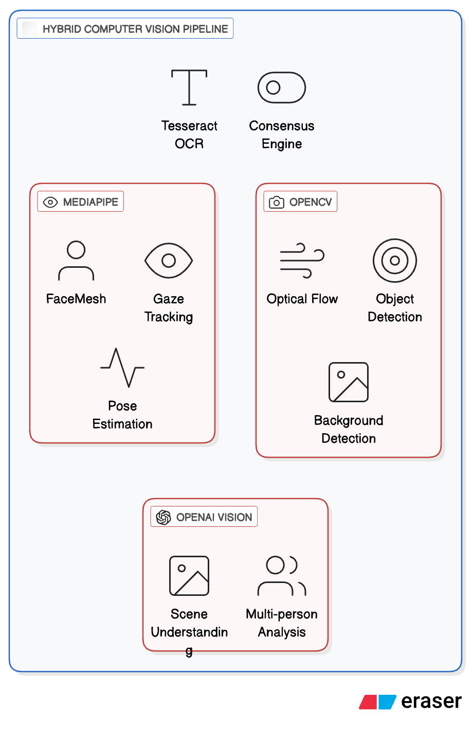
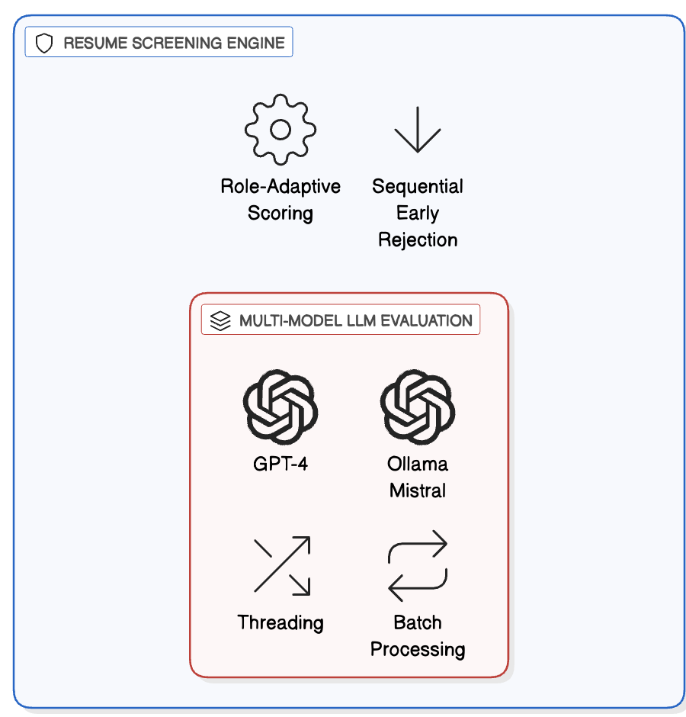
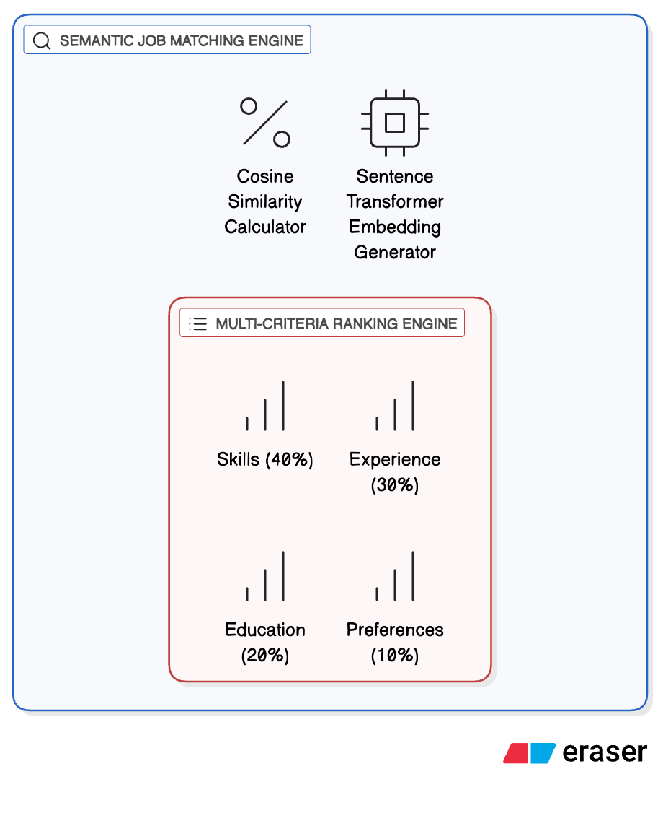
Methodology
(Processing Layer)

Slide 9
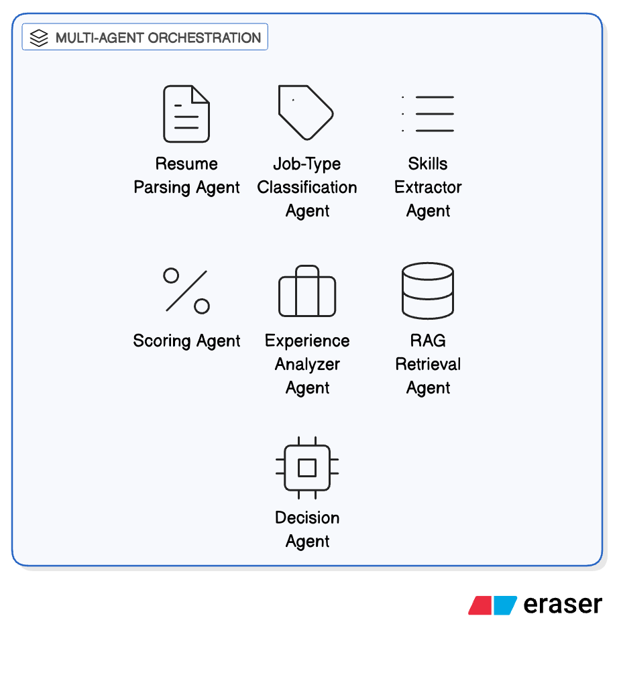
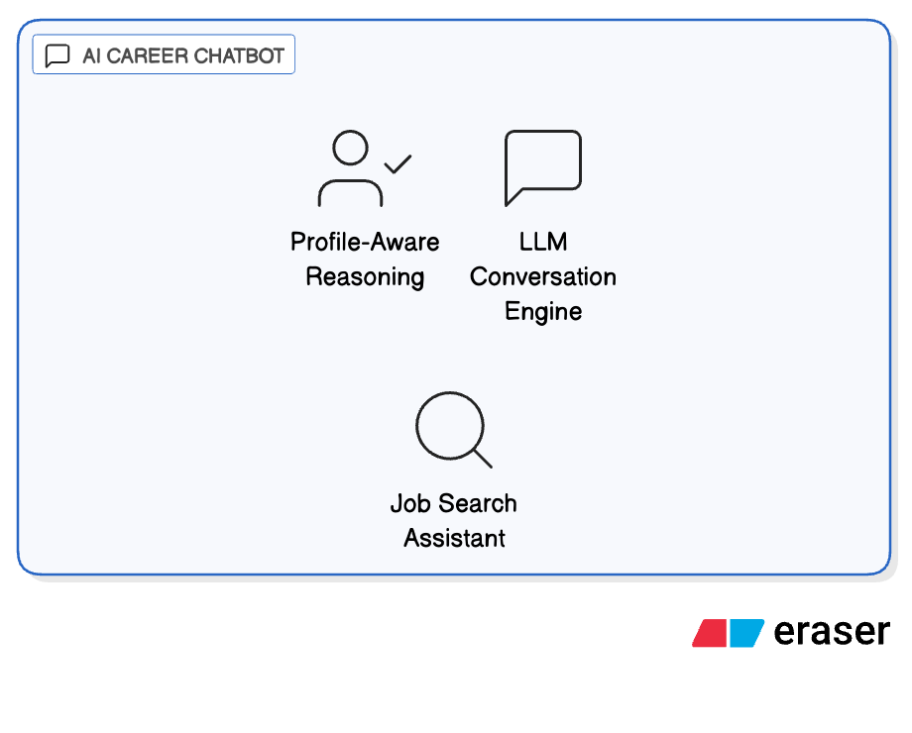
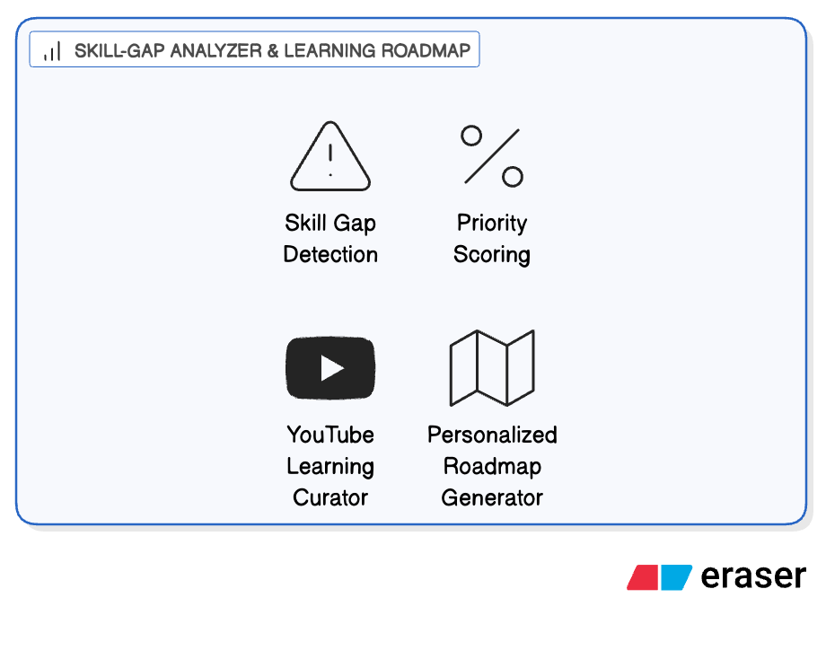
Methodology
(Processing Layer)

Slide 10
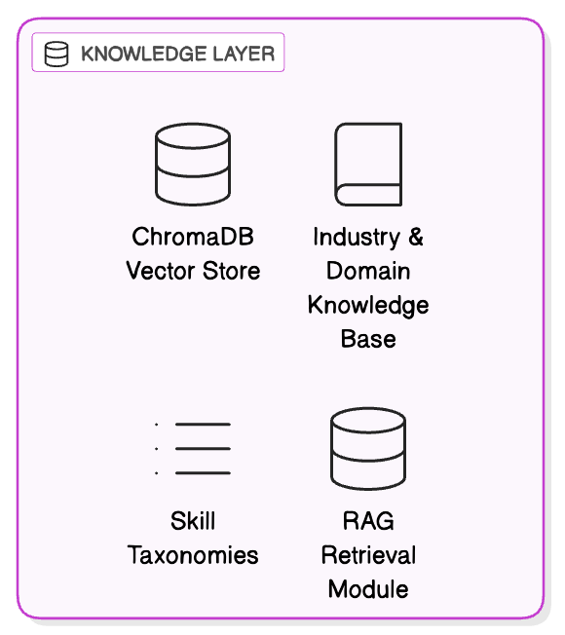
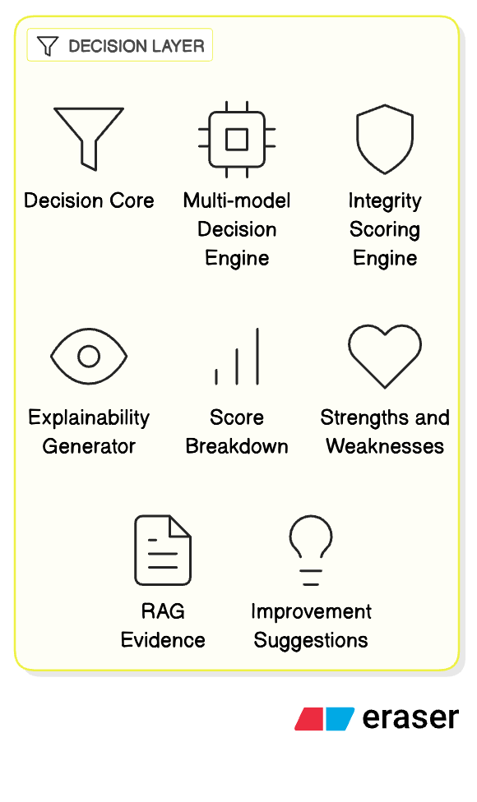
Methodology
(Knowledge and Decision Layer)

Slide 11
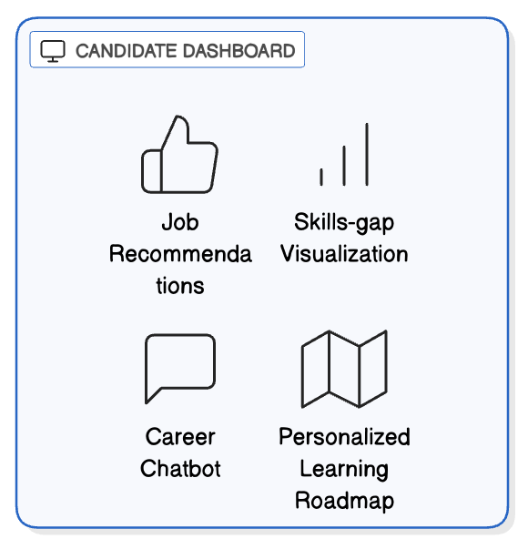
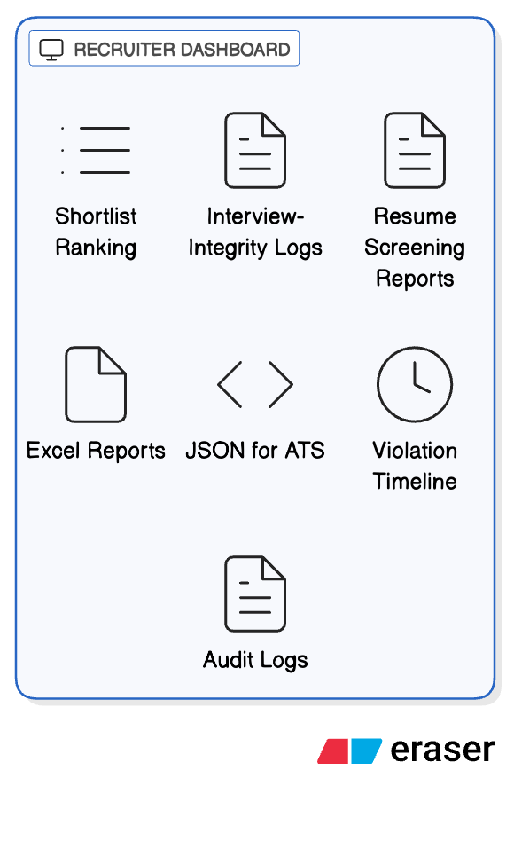
Methodology
(Output Layer)

Slide 12
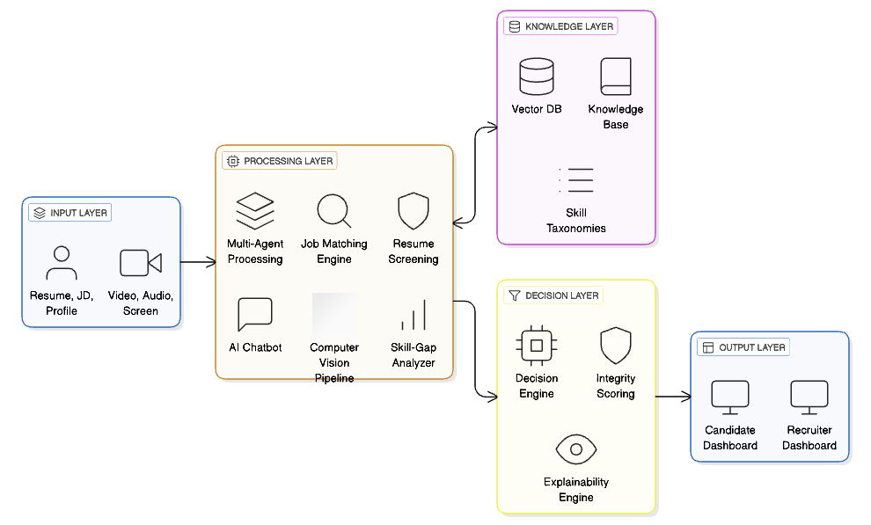
Methodology
(System Architecture Overview)

Slide 13
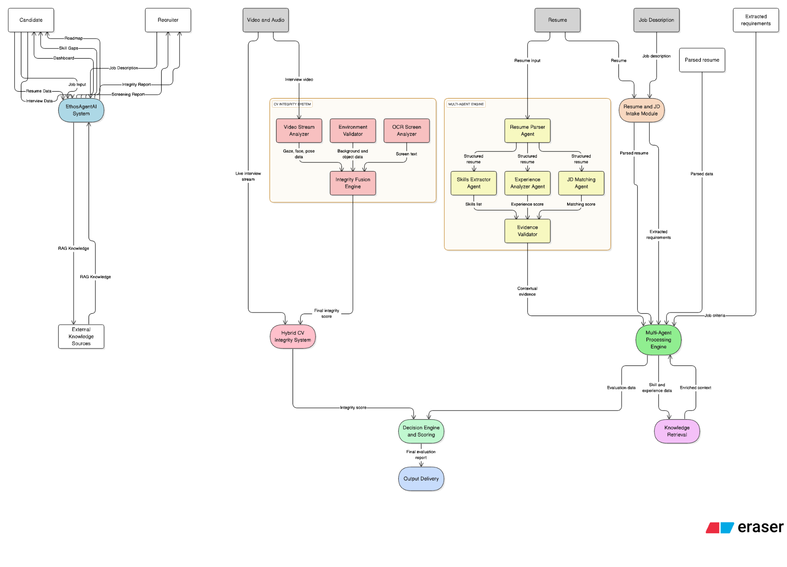
Methodology
(Data Flow Overview)

Slide 14
Result and Analysis
Resume Screening Results
Accuracy: 86% (vs Keyword 62%, Single-LLM 78%),
Precision: 0.84,
Recall: 0.86,
F1-Score: 0.85
System Efficiency
Avg. Screening Time: 22.6 sec / resume (60% faster than manual),
Early Rejection Processing: 18–22 sec,
Interview Latency: <100 ms,
Dashboard Response: 1.8–2.1 sec
Interview Integrity Accuracy
MediaPipe (Face & Pose): 96% ,
OpenCV Motion Detection: 93%,
OCR Content Detection: 92% ,
Vision Model (Scene Analysis): 97%,
Consensus Accuracy: 95–100%,
False Positives: <5%
Job Matching Results
Semantic Accuracy: 88% (vs Keyword 61%, Embedding-only 77%)

Slide 15
Analysis
Results confirm that EthosAgentAI significantly outperforms traditional keyword-based and single-model systems in both screening and matching accuracy.
High interview integrity accuracy with low false positives proves the reliability of the hybrid computer vision framework.
System efficiency improvements and low latency demonstrate practical real-world deployment feasibility.
Additionally, the platform supports personalized learning paths, enabling continuous skill development and adaptive feedback for candidates, further enhancing engagement and long-term growth.
Higher consistency, explainability, and bias resistance than human recruitment establish EthosAgentAI as a trustworthy ethical hiring system.

Slide 16
Novelty of the Work
Architectural: Integrates screening, matching, skills assessment, integrity checks, and guidance in a five-layer pipeline with hybrid cloud-local fallback.
Algorithmic: Consensus-based CV, role-adaptive scoring, sequential rejection for efficiency.
Methodological: First use of RAG in recruitment, LangGraph multi-agent coordination, explanation-first assessment.
Social/Ethical: Fairness-by-design, dual-sided support (candidates/recruiters), direct SDG 8 & 9 alignment.
Advances State-of-the-Art: Overcomes fragmentation in existing tools; Medium familiarity blending established (NLP, APIs) and novel (end-to-end fusion, behavioral consensus) elements.
Impact: Reduces bias, enhances reproducibility; Promising for future responsible AI systems.

Slide 17
Conclusion
EthosAgentAI is a personalized, multi-agent AI ecosystem that enhances hiring efficiency, equity, and transparency using advanced NLP, RAG, and hybrid computer vision. It achieves 86% resume screening accuracy, 95–100% interview integrity, and 88% semantic job matching. The platform uniquely delivers personalized skill-gap analysis, curated learning roadmaps, and an intelligent career-assistant chatbot, empowering candidates end to end. It advances SDG 8 by democratizing fair hiring and personalized career support, and supports SDG 9 through scalable, ethical AI innovation shifting recruitment from automation to lifelong personalized career intelligence.
Future Work:
Future enhancements include multimodal evaluation (text, visual, behavioral), predictive career trajectory modeling, and stronger bias mitigation with responsible AI alignment. Integration into the Daffodil Career Hub and nationwide rollout will enable large-scale, ethical deployment, making hiring and career development smarter, fairer, and more personalized.

Slide 18
References
[1] F. Cai, J. Zhang, and L. Zhang, "The impact of artificial intelligence replacing humans in making human resource management decisions on fairness: A case of resume screening," Sustainability, vol. 16, no. 9, p. 3840, 2024.
[2] A. Lacroux and C. Martin-Lacroux, "Should I trust the artificial intelligence to recruit? Recruiters’ perceptions and behavior when faced with algorithm-based recommendation systems during resume screening," Frontiers in Psychology, vol. 13, p. 895997, 2022.
[3] C. Harris, "Mitigating age biases in resume screening AI models," in The International FLAIRS Conference Proceedings, vol. 36, May 2023.
[4] F. P. W. Lo, J. Qiu, Z. Wang, H. Yu, Y. Chen, G. Zhang, and B. Lo, "AI hiring with LLMs: A context-aware and explainable multi-agent framework for resume screening," in Proceedings of the Computer Vision and Pattern Recognition Conference, pp. 4184-4193, 2025.
[5] P. W. Frank, Z. Wang, H. Yu, Y. Chen, G. Zhang, and B. Lo, "AI Hiring with LLMs: A Context-Aware and Explainable Multi-Agent Framework for Resume Screening," 2025.

Slide 19
THANK YOU

